Slide 1
Bike Life in Edinburgh
Group Member:
Xuanchen Yao,
Sally Bai,
Yao Tong

Slide 2
Project Context
The City of Edinburgh Council (CEC)
People’s cycling behaviour
Traffic Density
“a cycling and walking-friendly city”

Slide 3
Data Description
19+29
Hour-basis bike count each site
counter_id: the data is collected via labelled automatic counter (1-48);
date: the day on which the data was collected (18/03/2010);
time: the data is collected on an hourly-basis (0~23);
channel_1: the direction of travel (north-bound);
channel_2: the direction of travel (south-bound)

Slide 4
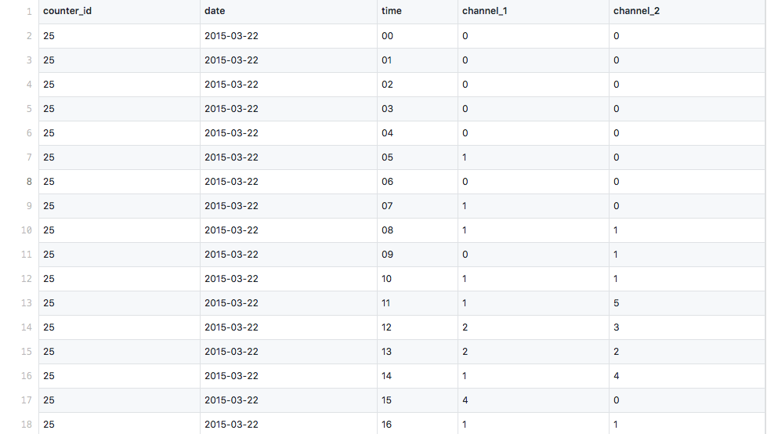

Slide 5
counter_id date time channel_1 channel_2
Total Traffic
Cycling behaviour
Cycling behaviour

Slide 6
Audience
New comers -> comics
Interested in cycling data -> line chart
Cycling campaign organizer

